Slide 1

Thinking
Audience(s)
Alumni and Development
Overview
Virtual Communications Lab
June 8, 2021
Notes:
Title Slide – Option 1

Slide 2
Thinking
Audience(s)
Jerry Kisslinger, DVP,
Strategic Communications
Sally Lee, Editor-in Chief,
Columbia Magazine
Gibson Knott, Senior
Director, CAA Marketing
Tracy Quinn, Senior Director,
Strategic Communications
Notes:
Title Slide – Senior Director for CAA Marketing-Digital Initiatives and OutreachOption 1

Slide 3
Thinking Audience
Starting with Goals and Insights
Who are we reaching and why? What do we want them to KNOW, FEEL, and DO?
What do we know about them to guide our efforts?
What is our INVITATION (CTA or otherwise)?

Slide 4
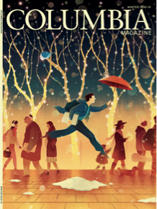
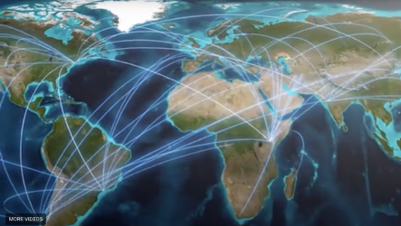
Our Audience Focus
Belonging
Broadening affiliation/expanding horizons
Notes:
-Turning readers/viewers into a community, inspiring a sense of belonging through connection to both University and one another, and into supporters
-Mix of Audiences: (1) scale from 1 to 350,000 (700,000 donors) plus public audience; (2) secondary audiences –campus, public media
-Identity Readership –expanding their horizon of the Columbia they knew and of themselves. Is this my club? We are selling them them as affiliated Columbians

Slide 5
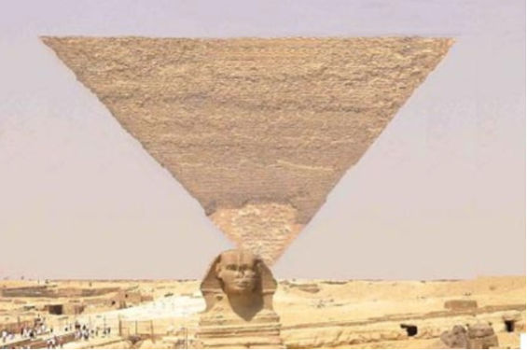
Strategic Audiences at Every Scale
From 350K+ to 1

Slide 6
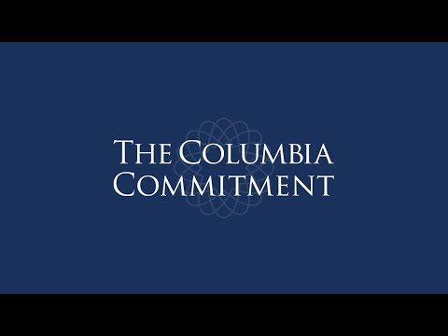
Campaign Messaging
Setting the Frame for The Columbia Commitment
Notes:
2016: A five year campaign for, ideas and impact. sometimes you come out ahead by what you DON’T DO.Columbia is people….wrestling with how to make the world better.

Slide 7
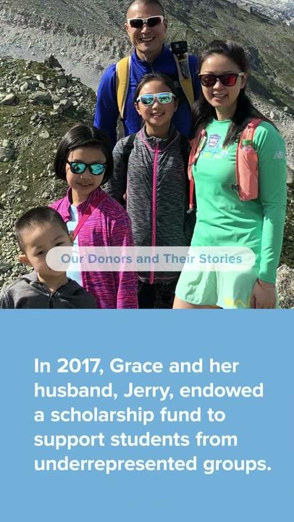
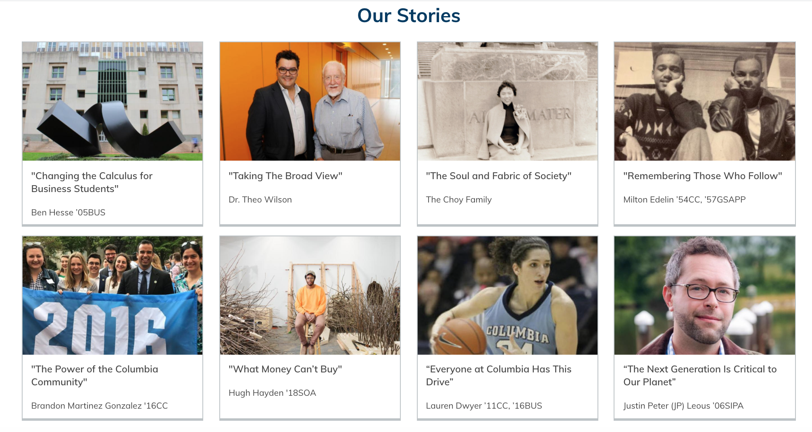
Why We Give: The Donor Lens
Notes:
Late campaign focus--the people, with emphasis on donors, and on student support. Social post used for: IG, Facebook, and LinkedIn

Slide 8
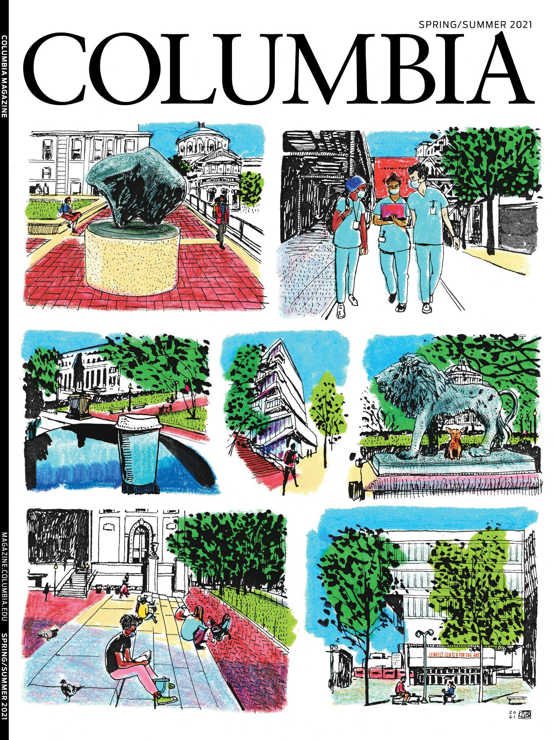
Columbia Magazine
•Print publication is sent to more than 350,000 alumni, faculty, staff, and select donors 3x a year
(May, Sept, Jan)
•40,000 issues sent to 188 countries and territories
•Website reaches up to 43,000 people per month

Slide 9
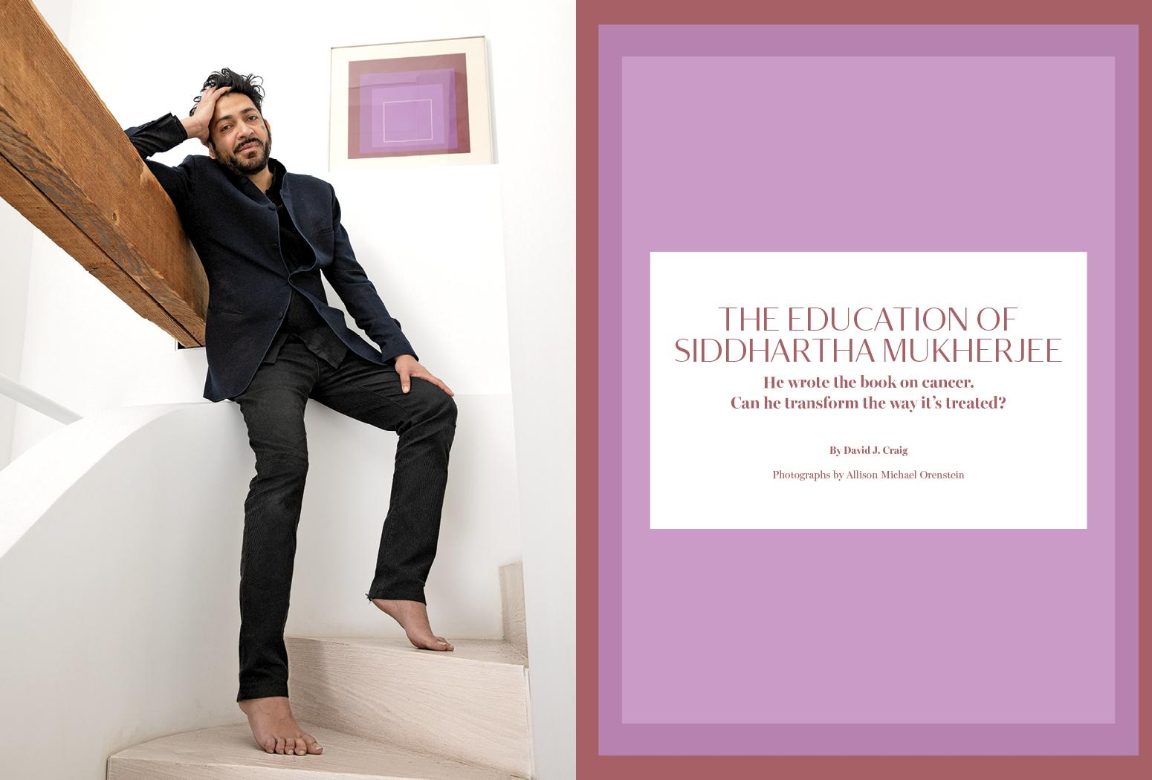
Be consumer-centric
“None of this is required reading.”
Jerry Kisslinger
Stories must be surprising, engaging, appeal to a wide audience, be timely, entertaining or provide service
We create stories that go beyond the academic context. Inspired by consumer magazines

Slide 10
You can survive without clickbait
Top stories online (last 12 months)
•Columbia in the Movies (21 films shot on campus)
•Old Friends (article on Sanford Greenberg and Art Garfunkel that spiked in traffic when People magazine referenced the story)
•29 Movie and TV Stars who Graduated from Columbia
•The Best Way to Stop a Negative-Thought Spiral (Q&A with psychologist Ethan Kross '07GSAS)
•The Lost Art of Dying Well (Q&A with medical ethicist Lydia Dugdale)
Hair-Regeneration Method the First to Grow New Follicles (Article that consistently gets Google traffic)
•Healing the Red-Blue Divide (Q&A with professor Peter T. Coleman '97TC)
•An Incomplete History of Columbia's Connections to the Highest Office in the Land (Columbia connections to US presidents)
•A New Way of Looking at Cancer (Mukherjee profile)
•15 Bingeable TV Shows Made by Columbia Graduates

Slide 11
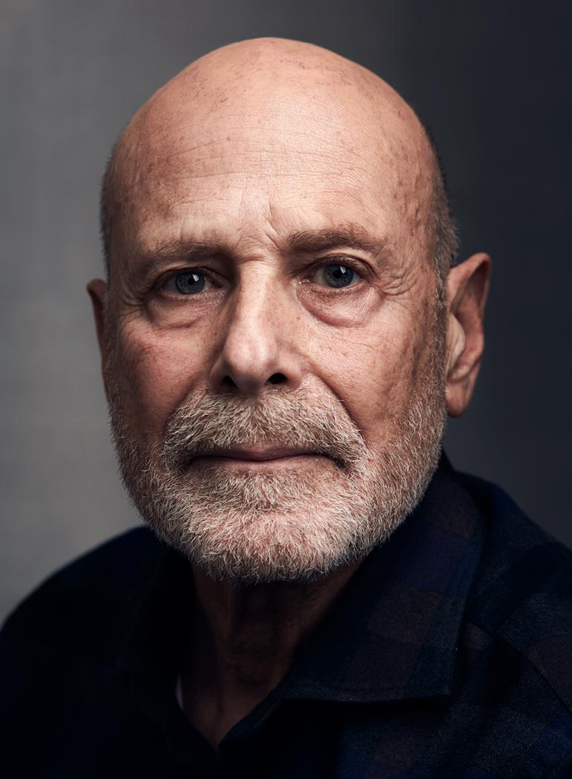
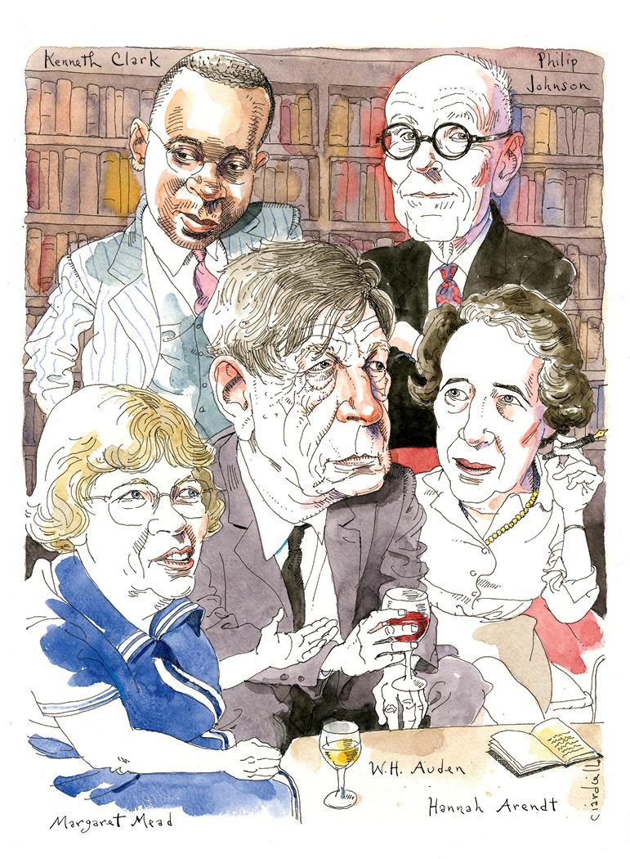
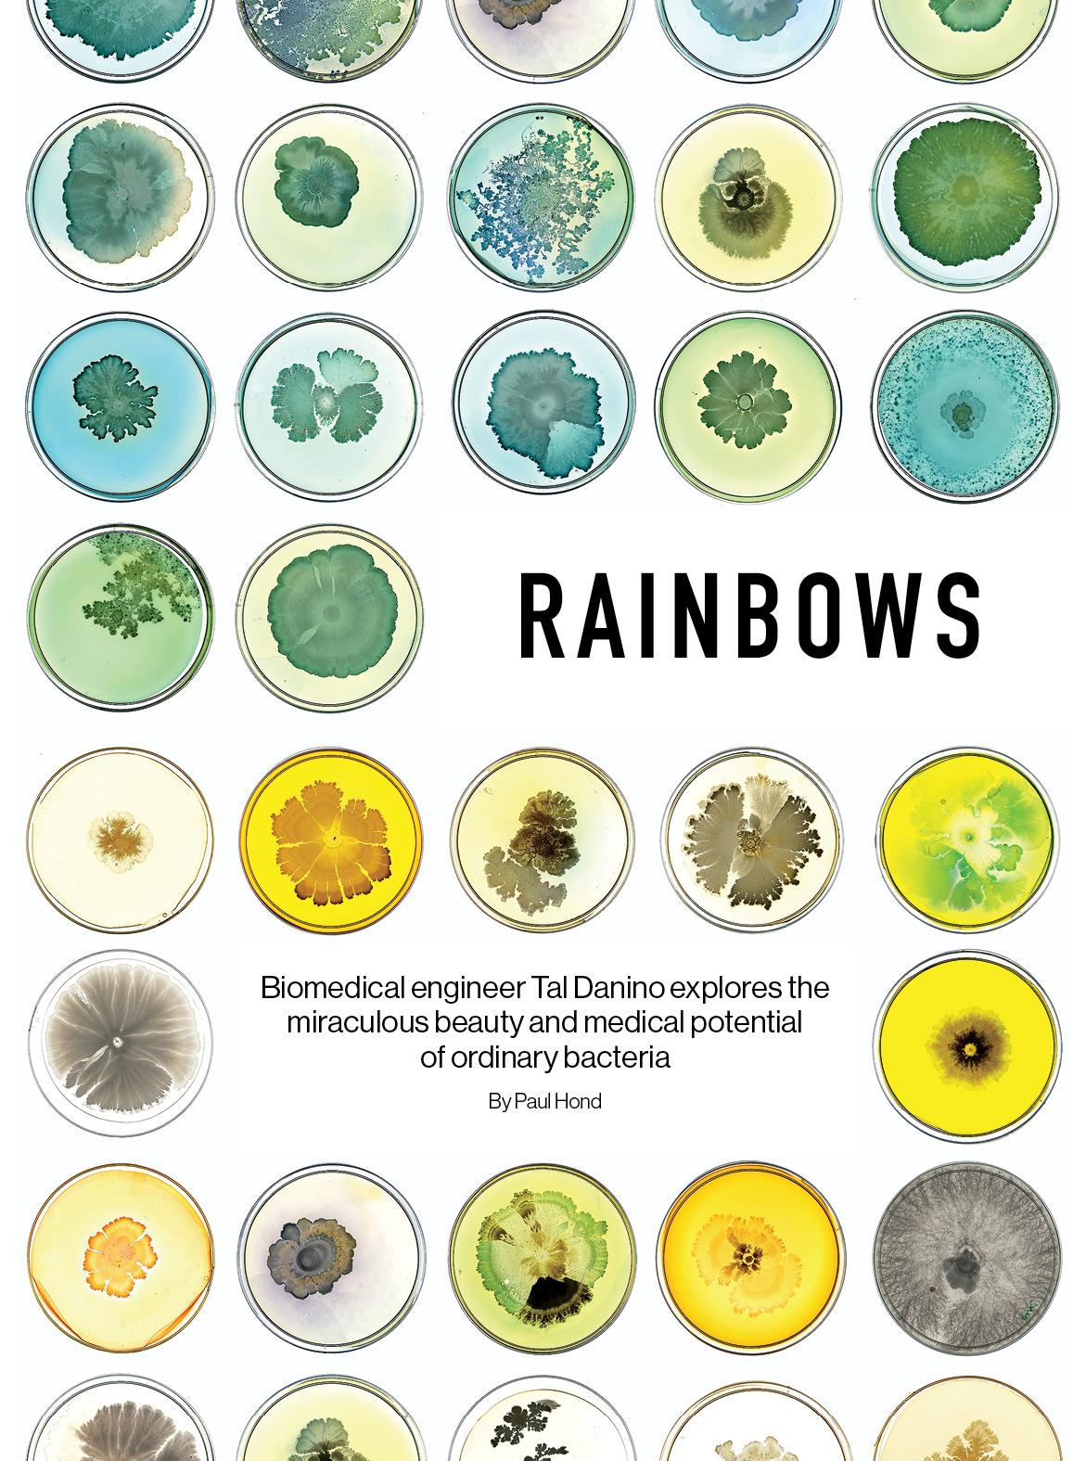
Invest in arresting visuals

Slide 12
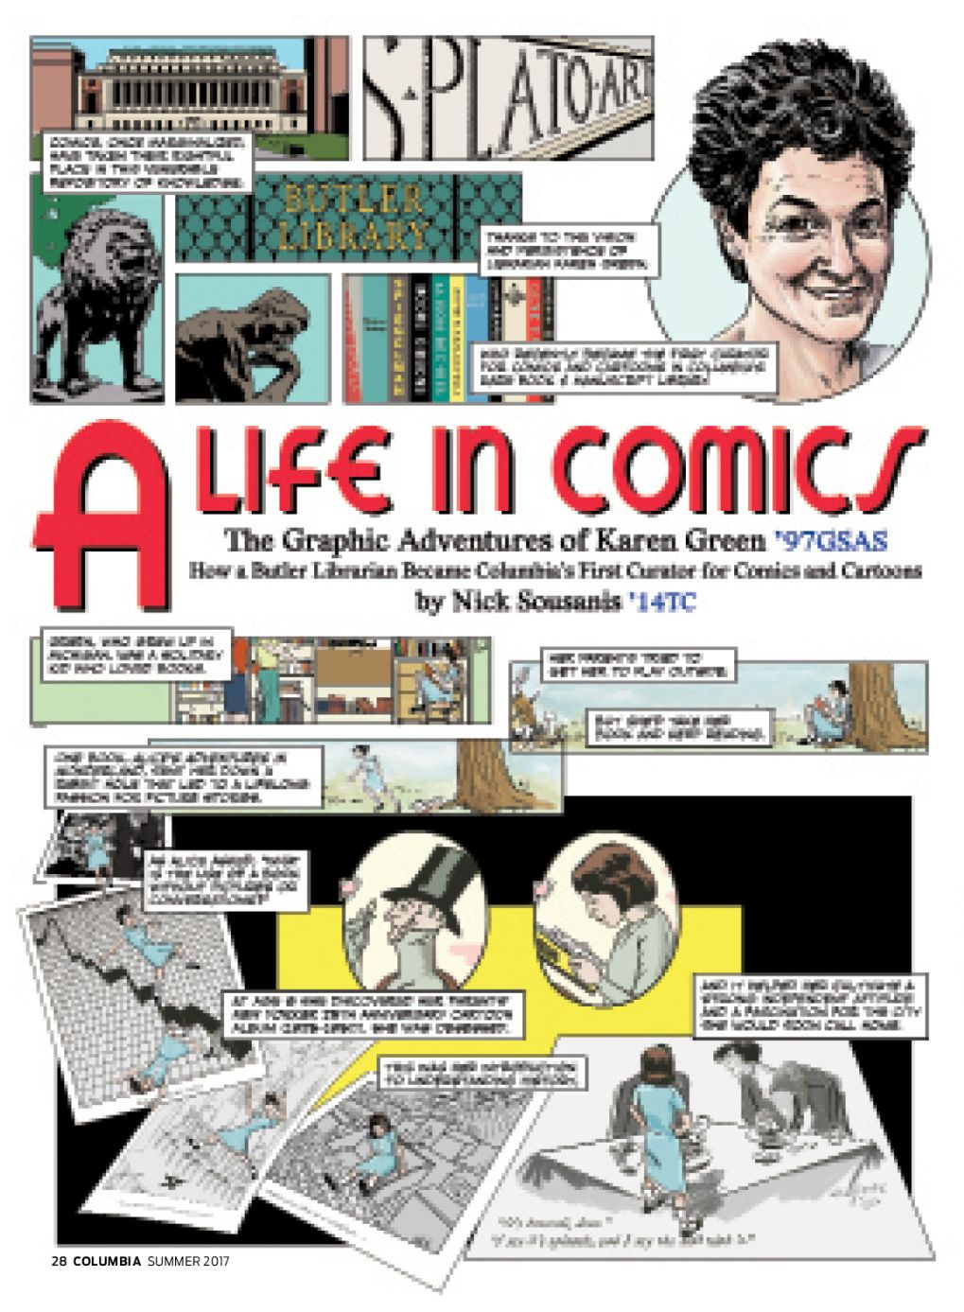
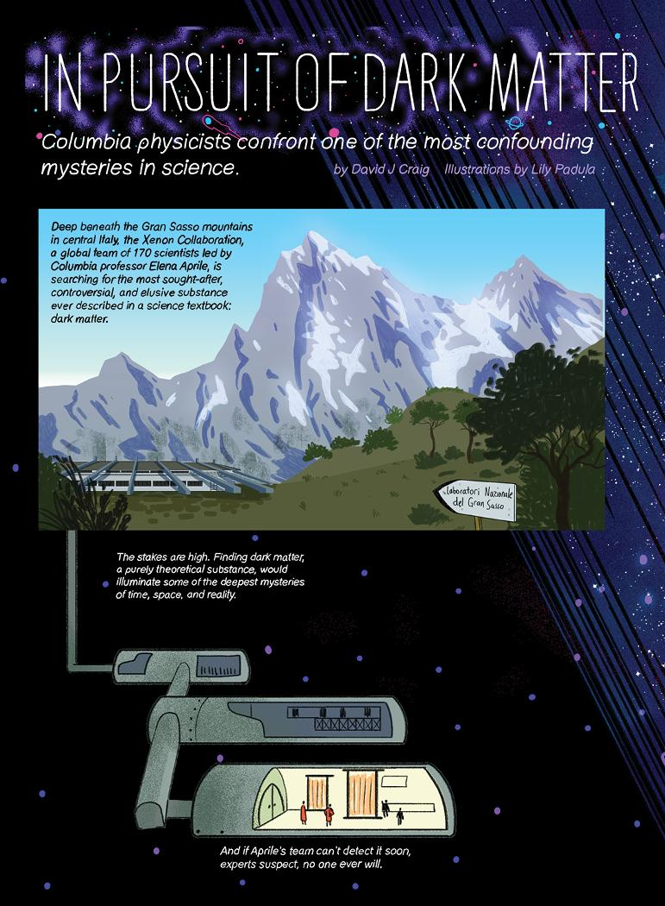
Experiment with formats
< Magazine won Eisner award at ComicCon for best short story
Finding simple ways to explain complex subjects >

Slide 13
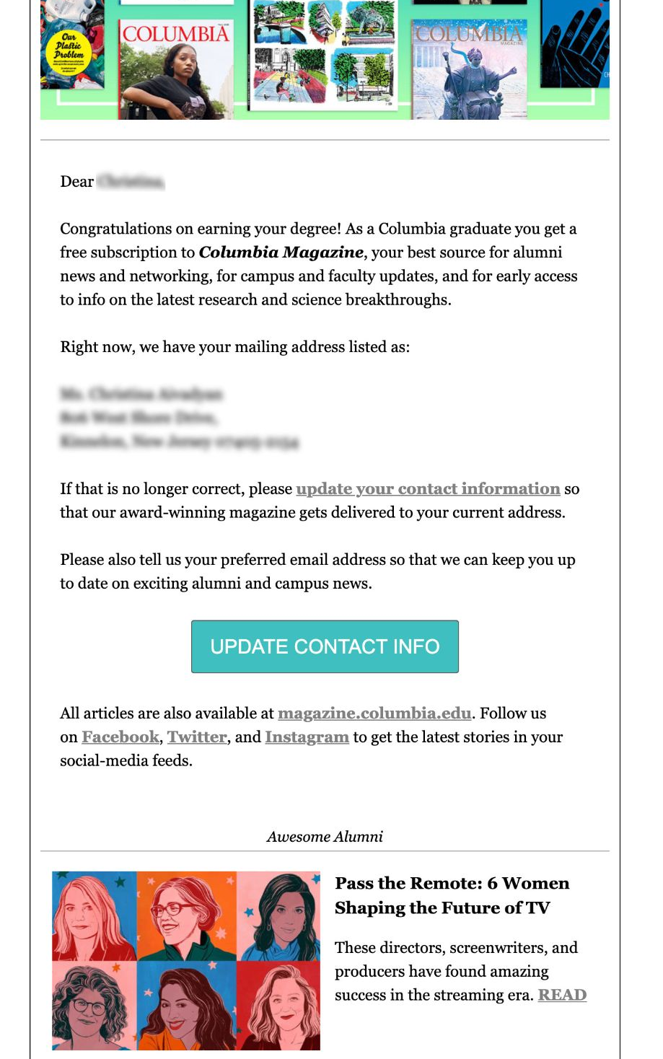
Information wanted
Last year our email to new grads saw a 68% open rate
More than 1,000 new grads followed the link to update their address
Magazine is seen as a gift
Badge quality of magazine
Print magazine cuts through digital clutter

Slide 14
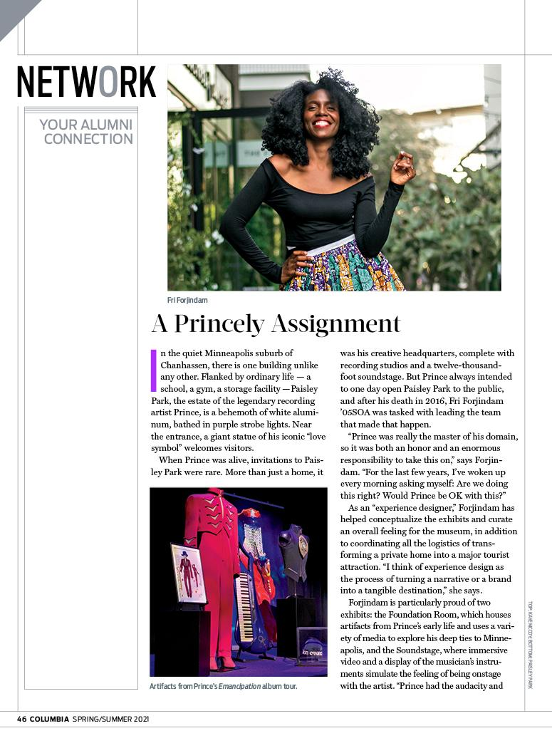
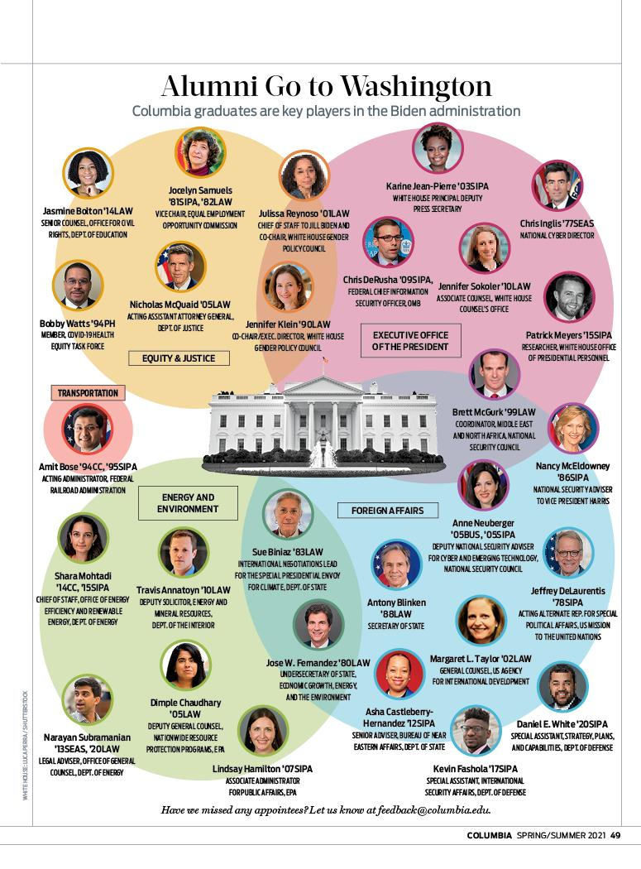
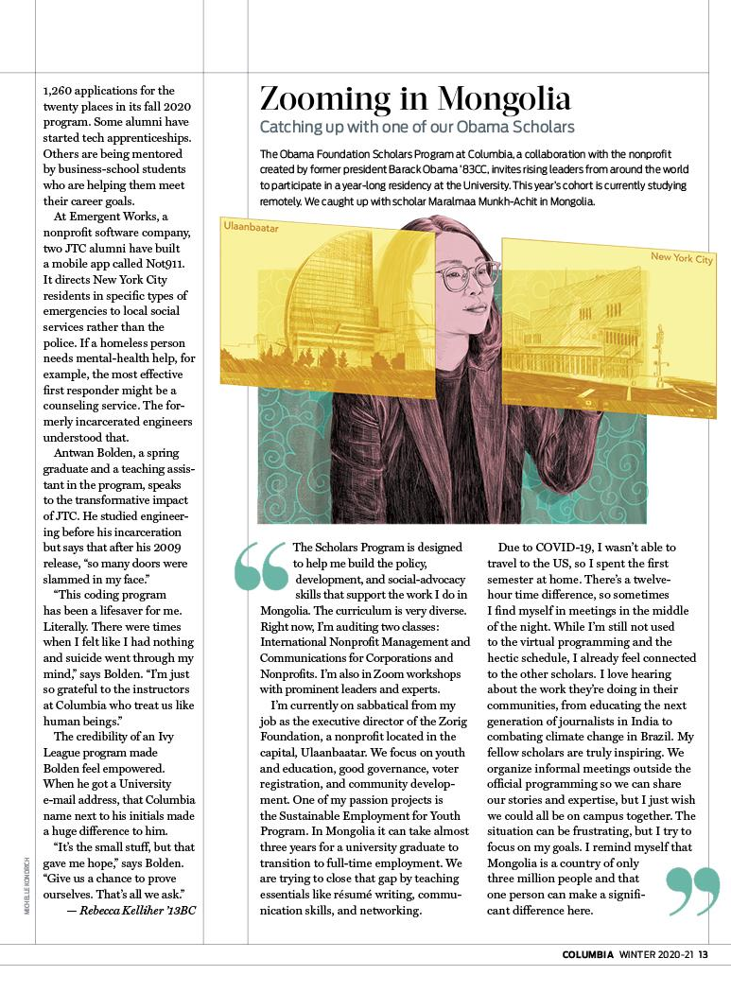
Building community
Magazine offers “Uber Class Notes” invites networking and connection and input
Reinforces sense of belonging to an important global community
Expands our idea of what it means to be a Columbian

Slide 15
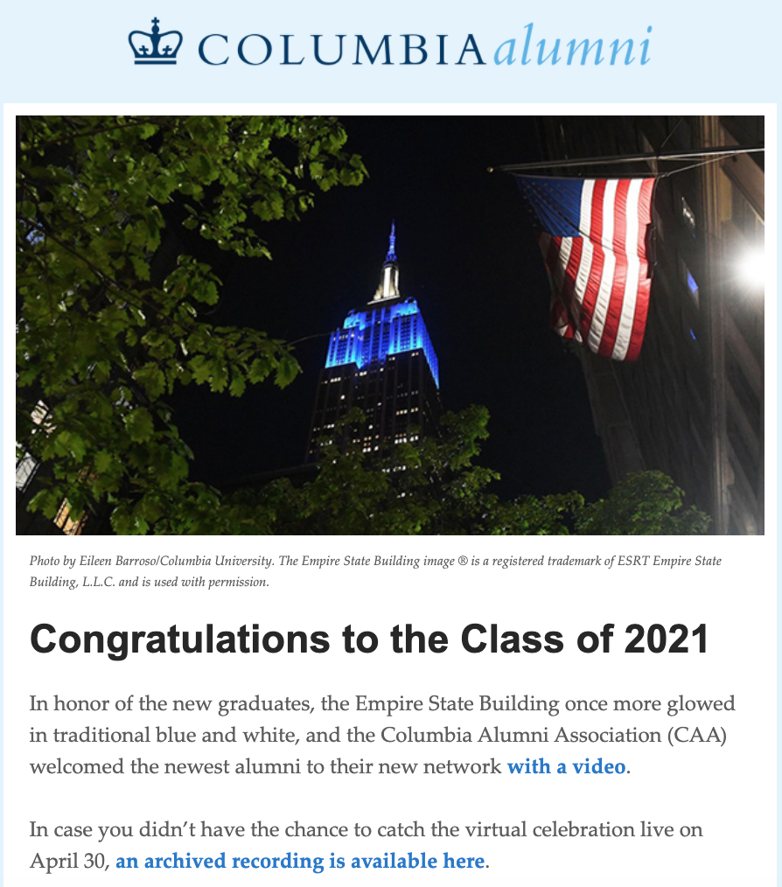
CAA Newsletter
Spotlight
Upcoming Events
Poll
News Around Columbia
Columbians Around the World
Benefits

Slide 16
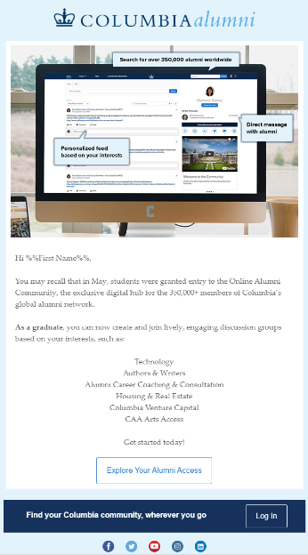
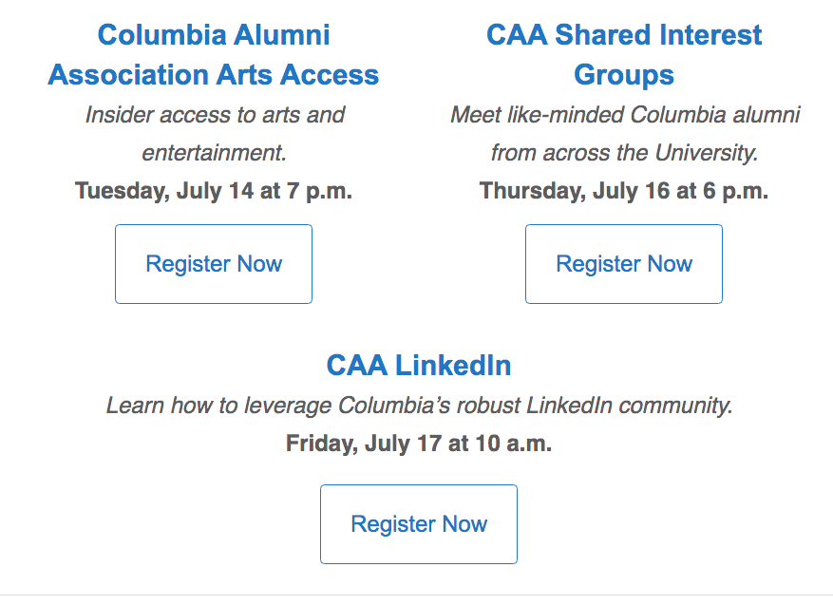
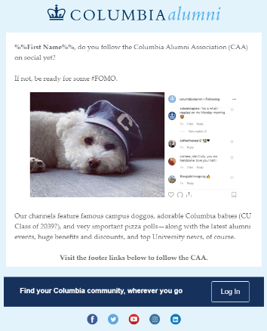
Targeted Emails (New Grads)
Segmented campaigns highlight audience appropriate opportunities.

Slide 17
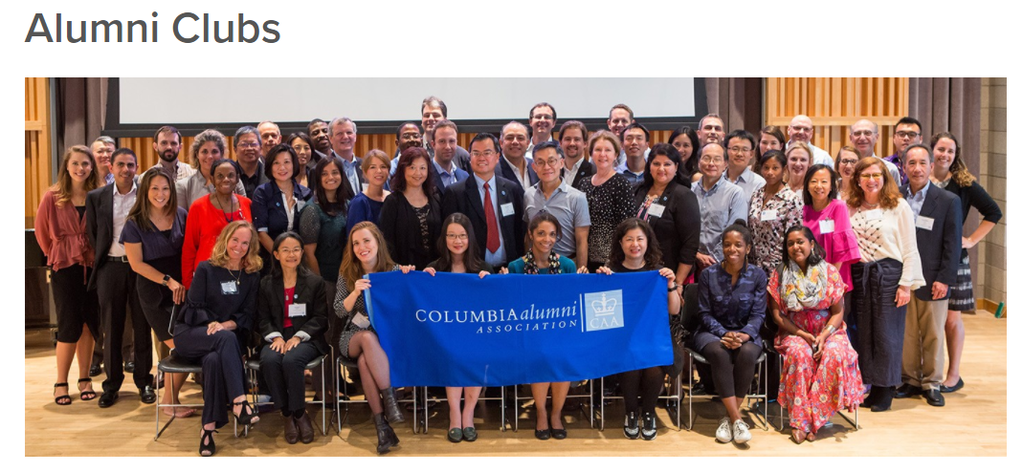
Opportunities to Connect
Online Book Club
Career Networking
Online Alumni Community
Social Media

Slide 18
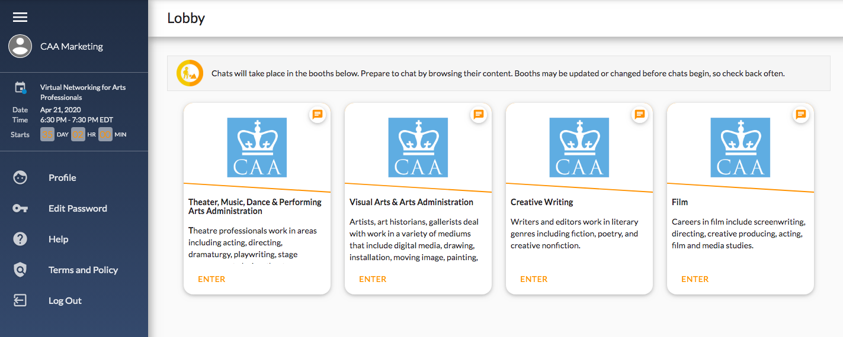
Brazen Networking

Slide 19
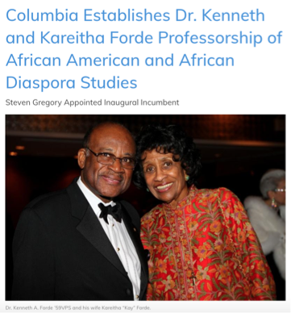
Making the News
Columbia.edu
Columbia News
CAA Newsletter
Arts and Sciences Newsletter
CUIMC Website
Just Societies Newsletter
Columbia Social Channels

Slide 20
Managing the News
Identify hot-button issues (emails, social media posts, phone calls)
Consult with Public Affairs about talking points, University statements, etc.
Develop communications strategy with key leadership and staff
Share aligned messaging as appropriate

Slide 21

Thanks! Questions?

